Slide 1


NatRisk project meeting - Erasmus+ funded international work placements (Internships) at Middlesex University
Dr Nosheen Rachel-Naseem
Erasmus & Exchange Manager

Slide 2
Erasmus-funded internships at Middlesex
Outbound students
Incoming students from Erasmus partner universities

Slide 3

Funded Erasmus Work Placement
Why doing an Erasmus Work Placement? | A fantastic opportunity for students to test their career ambitions and motivation. Working abroad boosts student’s confidence, enhances their CV, develops graduate level skills and global employability competencies that employers are looking for.
For how long? | Students may go abroad from 2 to 12 months.
When can students go? | During Term time (compulsory internships) During the summer break (voluntary internship); Immediately after graduation (voluntary internship)
What should students do to go on Erasmus Work Placement? | Talk to your Programme Leader for approval. Register your interest: http://bit.ly/regoabroad Improve your CV/Cover Letter with Employability’s help (employability@mdx.ac.uk) Look up and secure a WP in an organization in one of the following countries: Austria, Belgium, Bulgaria, Croatia, Cyprus, Czech Republic, Denmark, Estonia, Finland, France, Germany, Greece, Hungary, Ireland, Italy, Latvia, Lithuania, Luxembourg, Malta, Netherlands, Poland, Portugal, Romania, Slovakia, Slovenia, Spain, Sweden, Iceland, Liechtenstein, Norway, Turkey, Former Yugoslav Republic of Macedonia (Canary Islands, Guadeloupe, Martinique, French Guiana, Réunion, Azores, Madeira) Work Placement in student’s Home Country is allowed.
Students are responsible to find and secure the Work Placement! | Suggestions: 1. Ask for guidance and advice from the Employability Team; 2. Seek the advice and approval of your Programme Leader; Director of Studies 3. Do a Google Search; 4. Look into European Commission support websites: http://www.traineeup.com/en/ / http://erasmusintern.org / http://praxisnetwork.eu / http://www.placementslovakia.com / …
Email: ERASMUSWorkPlacements@mdx.ac.uk

Slide 4
Funded Erasmus Work Placement
Will students receive an Erasmus Grant? | The grants available will depend of the country where the student goes on exchange:
 | Countries | Monthly grant
 | Austria, Denmark, Finland, France, Ireland, Italy, Liechtenstein, Norway, Sweden | €450
 | Belgium, Croatia, Cyprus, Czech Republic, Germany, Greece, Iceland, Luxembourg, Netherlands, Portugal, Slovenia, Spain, Turkey, Bulgaria, Estonia, Hungary, Latvia, Lithuania, Malta, Poland, Romania, Slovakia | €400
I have secured a Work Placement, what should I do? | 1. Complete the form for Employability Team: http://goo.gl/forms/whRL1pt7Eg 2. To receive the Grant, send an email to ERASMUSWorkPlacements@mdx.ac.uk with your MDX number, the details of the host organisation (name, address, phone, email, etc.) and the start and end date of your exchange.
Email: ERASMUSWorkPlacements@mdx.ac.uk

Slide 5
Erasmus+ documents for work placements
Before the internship:
  Erasmus+ Traineeship Agreement: to be signed by the student, employability team/programme leader/research supervisor and the receiving university/company
  Erasmus+ Grant Agreement: to be signed by the student and the E&E team
During internship:
  Certificate of Attendance: to be completed, signed and stamped by the receiving university/organisation
After internship:
  Online Survey: compulsory online report sent to student’s email
  Feedback form

Slide 6
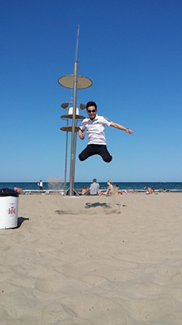
What do MDX students say?
“From the moment I arrived in Valencia to when I left, everyone was kind and helpful in helping me adjust to the cultural differences and showing patience with my poor Spanish skills.
This wasn't too much of a problem, because we had the Mediterranean right at our door step. As for our placement, I was working with FISH to identify and quantify microbes. I have learnt a lot about this technique and the potential applications of it. UPV has an amazing campus with incredible facilities and staff which I could write thousands of words on!
This was an amazing experience and I would just like say thank you again to everyone involved to make it happen.”
Rugare Maruzani, BSc Biosciences Student on Work Placement in Valencia, Spain

Slide 7
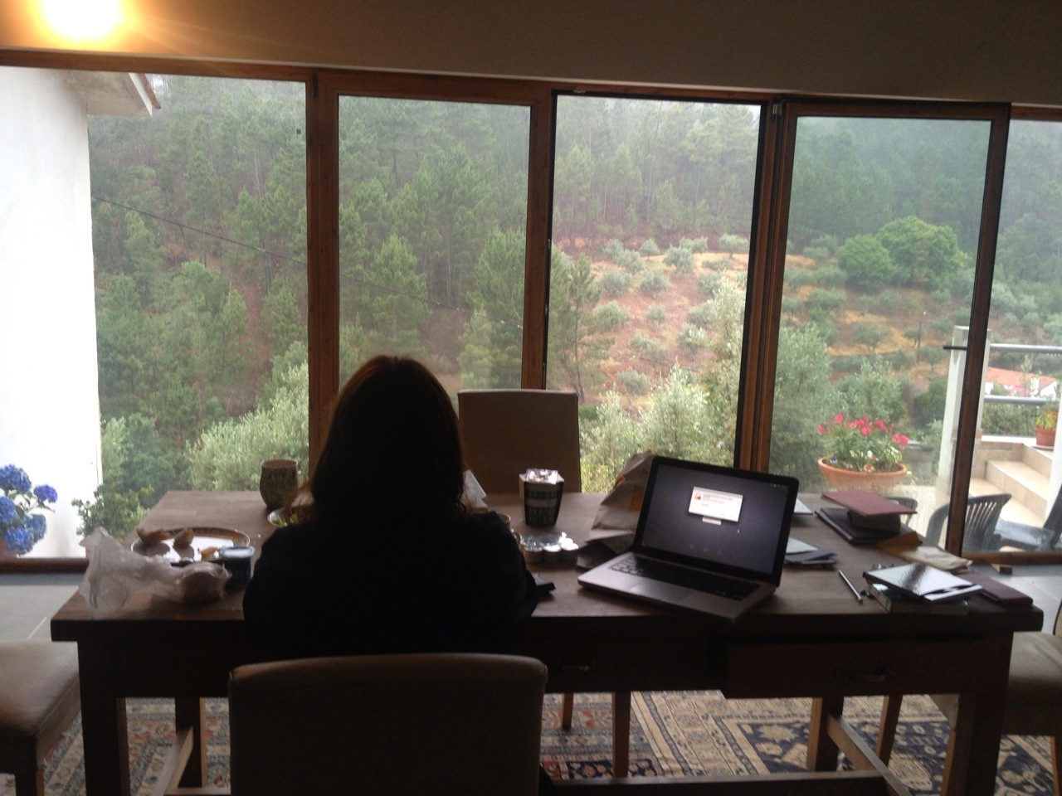
What do MDX students say?
  “The work placement focuses on my research and has provided an amazing opportunity to actually do some field work in Portugal, supported by my wonderful mentor….the Erasmus experience is not just about the work – it’s also about getting to know a country, its culture, its people.”
  -Patricia Jenkins – PhD, School of Media and Performing Arts, 2014/15 Erasmus
  doctoral placement, Instituto Polytécnico de Leiria (IPL), Portugal
“The natural, cultural, and historical heritage of this tiny nation located in the middle of the Mediterranean, whose language represents the missing link between my own Sicilian linguistic heritage and Arabic, definitely exceeded my expectations. I finalised my MA Translation dissertation, enjoying the rich collection of linguistic textbooks the library at the University of Malta has to offer, and the glorious weather too! An experience I would suggest to anyone.
- Andrea Musumeci, MA Translation, University of Malta

Slide 8
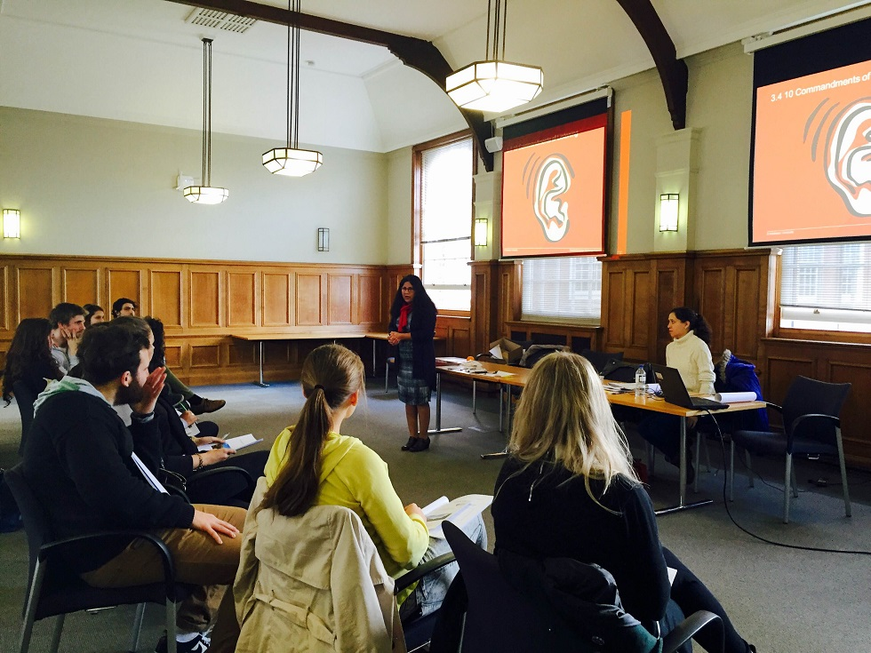
Student Exchange Mentoring Programme
Middlesex University has launched an exciting opportunity for students who are involved in Exchange Study Programmes. The Mentoring Scheme provides support to Middlesex inbound and outbound exchange students during their transition to the new country and whilst studying at the partner university or working in an enterprise or organisation. Within this scheme, trained returned and incoming exchange students (Mentors) provide assistance and support to students who are preparing for their exchange study (Mentees).
Mentors develop key skills which contribute to their employability. This is an opportunity to list practical experience in their CVs, and to create a talking point for future job interviews or applying for further study at international universities.
Mentees have the exceptional opportunity to receive guidance, encourage, support and inspiration from Mentors who match on their profile. They receive practical advice on issues such as time management, organizational ability, academic support and general assistance to prepare them towards their work placement/internship.

Slide 9

Student Exchanges Team
Thank you for your attention!
Any questions?
Website:
http://unihub.mdx.ac.uk/your-study/student-exchange
Email us:
erasmusworkplacements@mdx.ac.uk
Employability Team:
employability@mdx.ac.uk
Phone:
+44 (0)20 8411 5579

